Slide 1
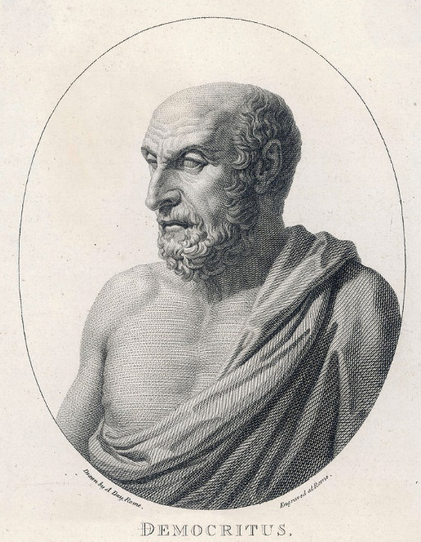
Basic Principles of Power Electronics
Supervisor: Professor Nikolaos Papanikolaou
Reference Design of a DC/DC Switch Mode Power Supply (SMPS) – Multi Output (Flyback
Converter)

Slide 2

Contact details
First Name | Last Name | Register Number | University e-mail | Second e-mail
Victor | Michailidis | 57729 | viktmich3@ee.duth.gr | v.michailidis2000@gmail.com
Victor | Siouras | 57990 | viktsiou1@ee.duth.gr | vsiouras@gmail.com
Anastasios | Karatzoglou | 57825 | anaskara34@ee.duth.gr | mounakos2000@gmail.com
Panagiotis | Rigas | 56841 | panariga@ee.duth.gr | wolfmang4@gmail.com
Panagiotis | Christodoulou | 57861 | panachri8@ee.duth.gr | panoschr2@gmail.com
Basic Principles of Power Electronics
Supervisor: Professor Nikolaos Papanikolaou
Notes:
Choose the nearest impedance

Slide 3
Table of Contents
Introduction | Anastasios Konstantinos Karatzoglou
Basic Principles of Flyback Converter | Anastasios Konstantinos Karatzoglou
IC Basic Function | Panagiotis Rigas
IC Internal Regulator and Soft Start | Panagiotis Christodoulou
IC Compensation and UVLO blocks | Victoras Siouras
IC Protection blocks | Victor Michailidis
Katakleida | Victor Michailidis
Intelligent Controlles | Panagiotis Rigas
Discussion and Questions
Basic Principles of Power Electronics
Supervisor: Professor Nikolaos Papanikolaou
Notes:
Choose the nearest impedance

